Slide 1


Machine
Learning
Demystifying the World of Artificial Intelligence and Exploring Its Potential

Slide 2
AI vs ML vs DL
Artificial Intelligence
Artificial Intelligence
A technique which enables machines to mimic human behavior.
Machine Learning
Machine Learning
Subset of Al technique which use statistical tools to explore and analyze the data.
Deep Learning
Deep Learning
Subset of ML which make the computation of multi-layer neural network feasible

Slide 3
Machine Learning (ML)
Supervised learning
Unsupervised learning
Fundamental Principles that Guide ML

Slide 4

Machine Learning (ML)
Supervised learning
Unsupervised learning
Labeled training data enables the algorithm to map inputs to outputs.
Fundamental Principles that Guide ML

Slide 5
Machine Learning (ML)
Supervised learning
Labeled training data enables the algorithm to map inputs to outputs.
Unsupervised learning
Our Model
Fundamental Principles that Guide ML

Slide 6
Machine Learning (ML)
Supervised learning
Labeled training data enables the algorithm to map inputs to outputs.
Unsupervised learning
Train Data
Panda
Annotations
These are Pandas
?? Test Data
Fundamental Principles that Guide ML

Slide 7

Machine Learning (ML)
Unsupervised learning
Supervised learning
Unlabeled training data allows the algorithm to uncover patterns and hidden structures.
Fundamental Principles that Guide ML

Slide 8
Machine Learning (ML)
Unsupervised learning
Unlabeled training data allows the algorithm to uncover patterns and hidden structures.
Supervised learning
Hi again..!
Fundamental Principles that Guide ML

Slide 9
Machine Learning (ML)
Unsupervised learning
Unlabeled training data allows the algorithm to uncover patterns and hidden structures.
Supervised learning
Train Data
Fundamental Principles that Guide ML

Slide 10
Machine Learning
Task Driven
Data Driven
Supervised Learning
Unsupervised Learning
(Unlabeled Data)
(Pre-Categorized Data)
Classification
Regression
Clustering
Association
Dimensionality Reduction
(Divide the Similarity)
(Identify Sequences)
(Wider Dependencies)
(Divide the Socks by Color)
(Divide the Ties by Length)
E.g. Targeted Marketing
E.g. Customer Recommendation
E.g. Big Data Visualization
Obj: Pattern/ Structure Recognation
E.g. Identify Fraud Detection
E.g. Market Forecasting
Obj: Predications + Predictive Models
Machine Learning

Slide 11
Machine Learning
Task Driven
Data Driven
Supervised Learning
Unsupervised Learning
(Pre-Categorized Data)
(Unlabeled Data)
Classification
Regression
(Divide the Socks by Color)
(Divide the Ties by Length)
Dimensionality Reduction
Clustering
Association
E.g. Identify Fraud Detection
E.g. Market Forecasting
Obj: Predications + Predictive Models
(Divide the Similarity)
(Identify Sequences)
(Wider Dependencies)
E.g. Targeted Marketing
E.g. Customer Recommendation
E.g. Big Data Visualization
Obj: Pattern/ Structure Recognation
Machine Learning

Slide 12
Machine Learning
Task Driven
Data Driven
Supervised Learning
Unsupervised Learning
(Pre-Categorized Data)
(Unlabeled Data)
Classification
Regression
Clustering
Association
Dimensionality Reduction
(Divide the Socks by Color)
(Divide the Ties by Length)
(Divide the Similarity)
(Identify Sequences)
(Wider Dependencies)
E.g. Identify Fraud Detection
E.g. Market Forecasting
E.g. Targeted Marketing
E.g. Customer Recommendation
E.g. Big Data Visualization
Obj: Predications + Predictive Models
Obj: Pattern/ Structure Recognation
Machine Learning

Slide 13

Linear Regression
used to predict the value of a variable based on the value of another variable
Machine Learning

Slide 14
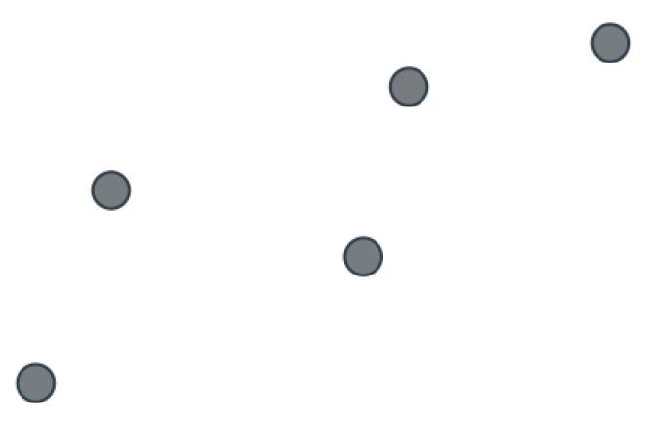
What is linear regression?
Can you design a linear road that pass by all these houses equally?!
Machine Learning

Slide 15
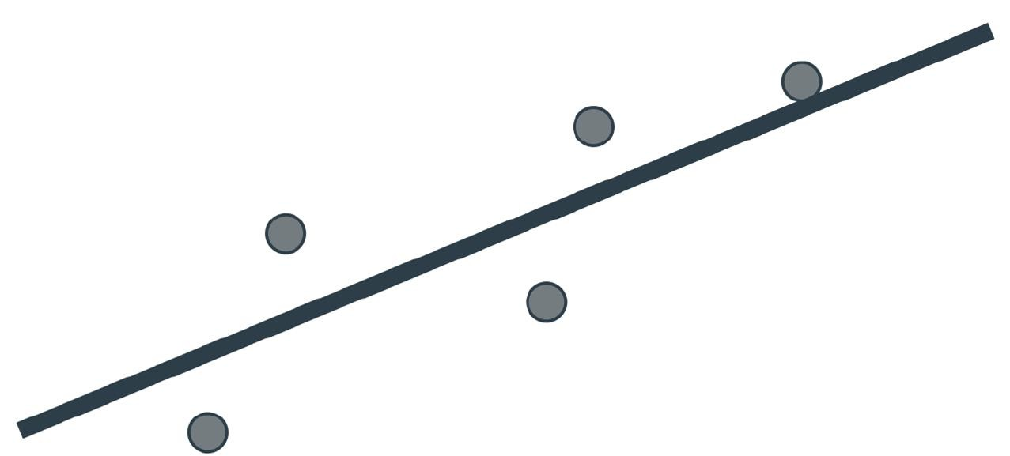
What is linear regression?
Can you design a linear road that pass by all these houses equally?!
Machine Learning

Slide 16
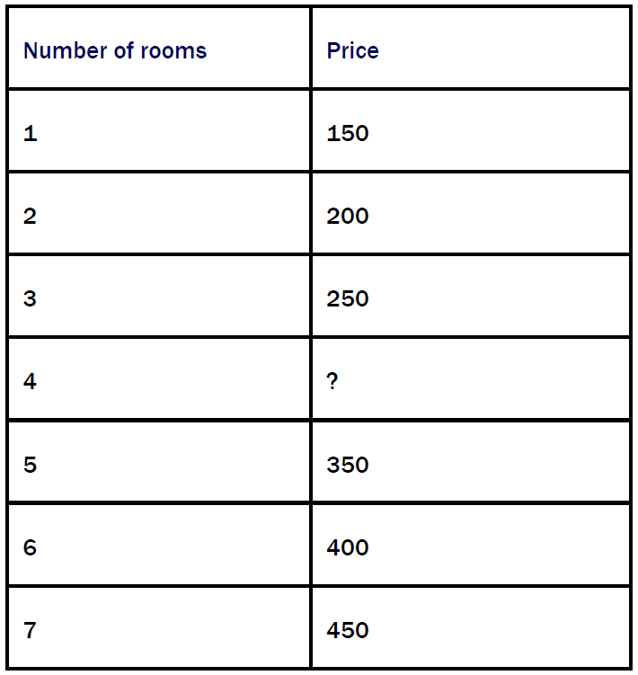
Housing prices problem
What are the features and labels here?
Is it classification or regression problem?
What is the price of the house of 4 rooms?
What is the price per extra room?(#Room weight)
What is the base price?(Bias)
What is equation that represent the price?
Price = 100 + 50 * (Number of rooms)
Machine Learning

Slide 17
Weights and Bias
Price = 100 + 50 * (Number of rooms)
WEIGHTS In the formula corresponding to the model, each feature gets multiplied by a corresponding factor. These factors are the weights. In the above formula the only feature is the number of rooms, and its corresponding weight is 50.
BIAS As you can see, the formula corresponding to the model has a constant that is not attached to any of the features. This constant is called the bias. In this model, the bias is 100 and it corresponds to the base price of a house.
How machines learn this equation?
Machine Learning

Slide 18
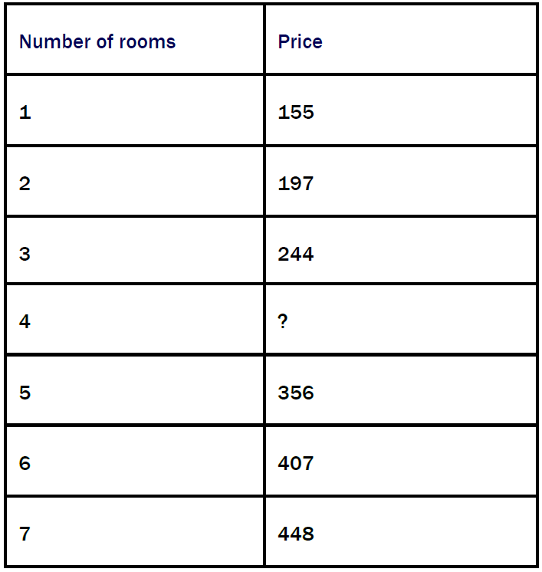
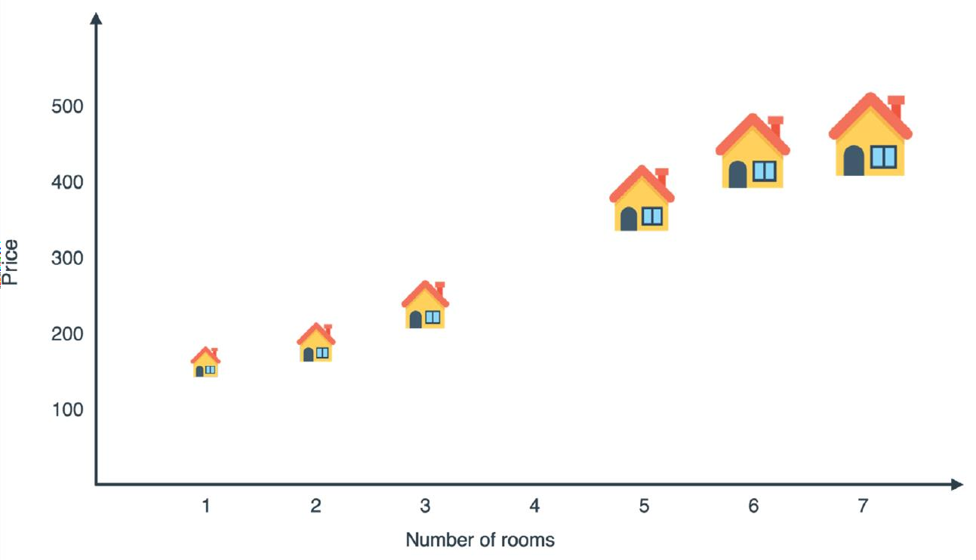
How machines learn it? [Remember-Formulate-Predict]
Machine Learning

Slide 19
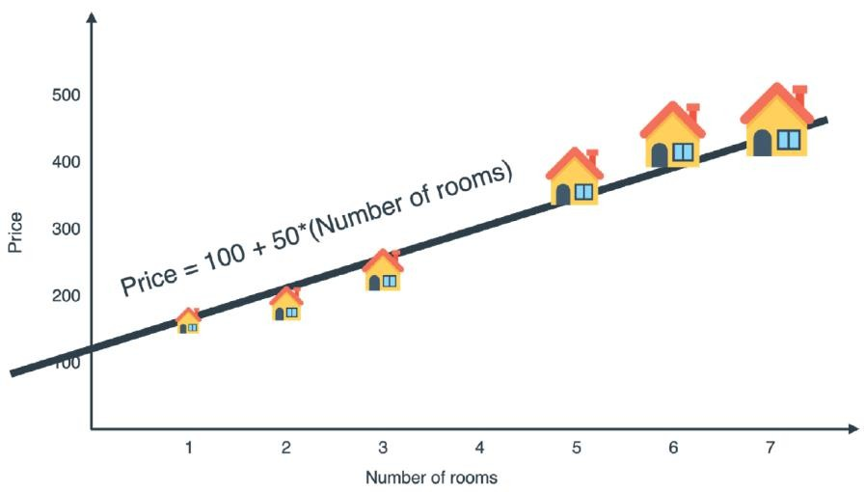
How machines learn it? [Remember-Formulate-Predict]
Price = 100 + 50 * (Number of rooms)
Machine Learning

Slide 20
How machines learn it? [Remember-Formulate-Predict]
Price = 100 + 50 * (Number of rooms)
Slope measures how steep the line is. It is calculated by dividing the rise over the run.
Y-intercept is the height at which the line crosses the vertical (y) axis.
Linear Equation is the equation of a line. y=mx+b
How many lines can solve the problem?
Machine Learning

Slide 21
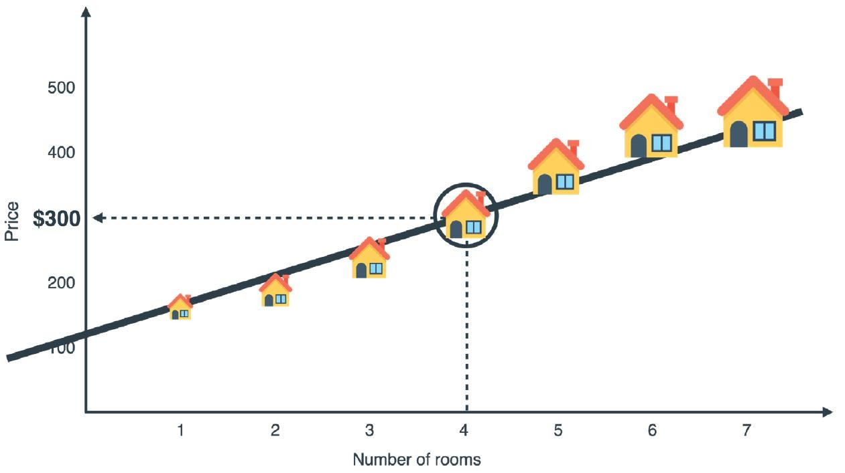
How machines learn it? [Remember-Formulate-Predict]
Price = 100 + 50 * (Number of rooms)
Price = 100 + 50 * (4)= 300
Some Questions:
Can we have multiple features data?
How does computer
get this equation?
Machine Learning

Slide 22
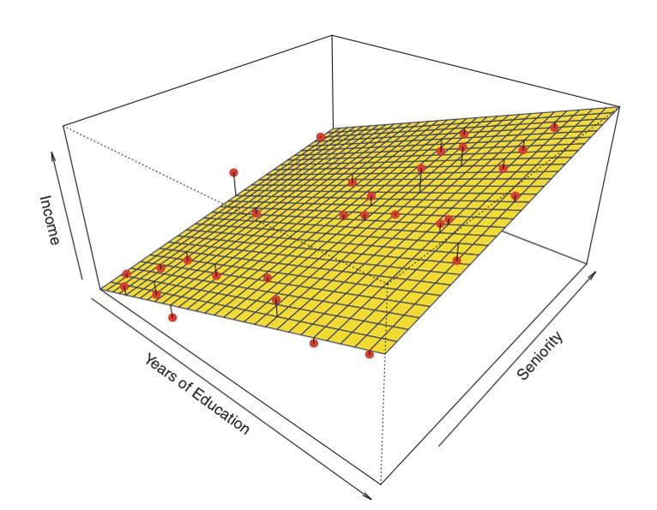
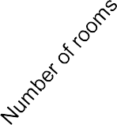

Multivariate Linear Regression
Price = 30*(number of rooms) + 1.5*(size) + 10*(quality of the schools) - 2*(age of the house) + 50
What do you notice in this equation?
1 bias and multiple weights
Different sign of weights
Different weights value
What is shape of the model? Still linear?
Machine Learning

Slide 23
How machines formulate this equation?[Overview]
Inputs: A dataset of points.
Outputs: A linear regression model that fits that dataset.
Procedure:
Pick a model with random weights and a random bias.
Repeat many times:
  Pick a random data point.
  Slightly adjust the weights(Slope) and bias(y-intercept) in order to improve the prediction for that particular data point.
Return the model you’ve obtained.
Machine Learning

Slide 24
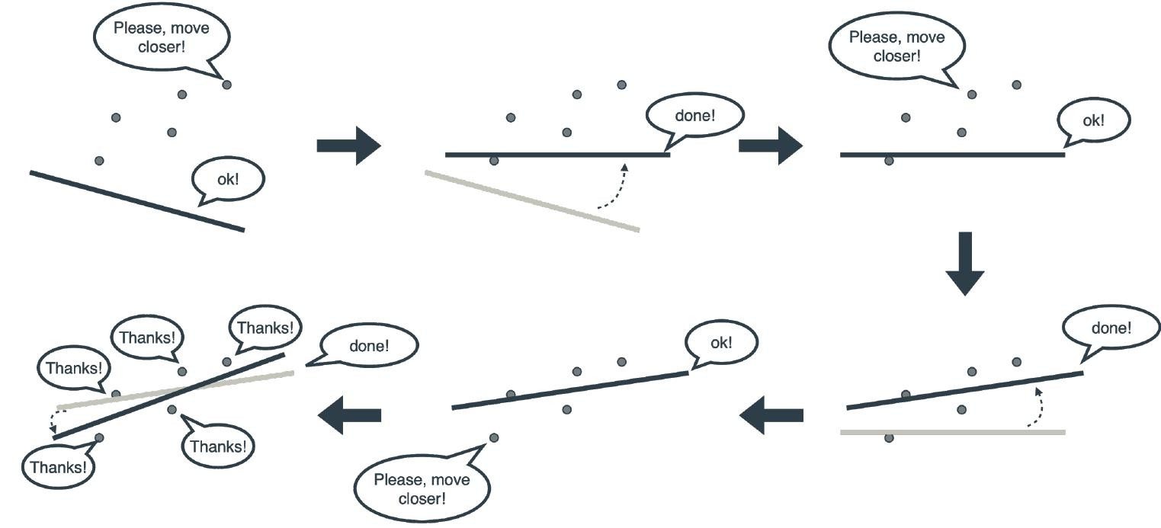
How machines formulate this equation?[Overview]
Machine Learning

Slide 25
How machines formulate this equation?[Overview]
Machine Learning

Slide 26
How machines formulate this equation?[Overview]
Machine Learning

Slide 27
How machines formulate this equation?[Overview]
Machine Learning

Slide 28
How machines formulate this equation?[Overview]
Machine Learning

Slide 29
How machines formulate this equation?[Overview]
Machine Learning

Slide 30
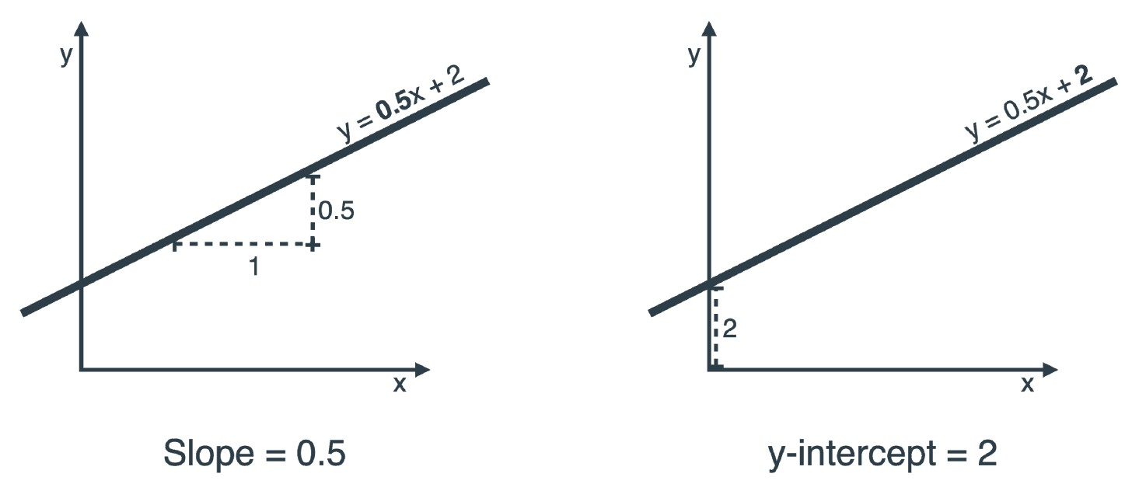
Slope and Y-intercept
Machine Learning

Slide 31
Slope and Y-intercept
Machine Learning

Slide 32
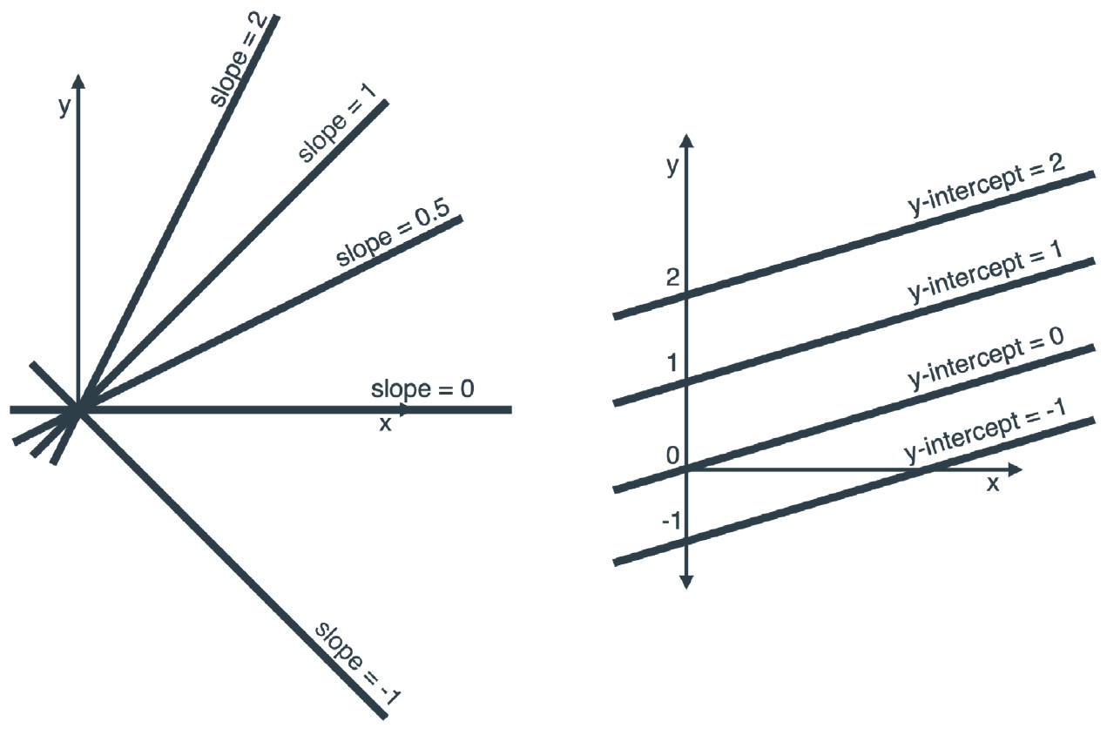
Slope and Y-intercept
Machine Learning

Slide 33
Slope and Y-intercept
Machine Learning

Slide 34
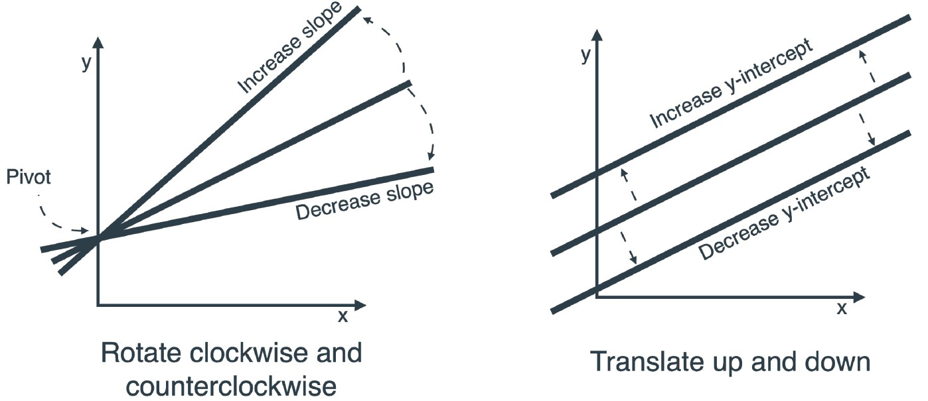
Slope and Y-intercept
Machine Learning

Slide 35
Slope and Y-intercept
Machine Learning

Slide 36
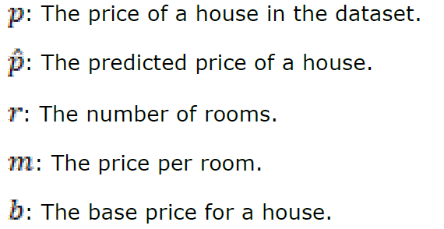

Some variables of equation
y=mx+b
Machine Learning

Slide 37
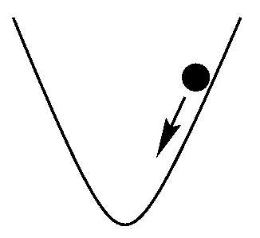
What is learning rate?
A very small number that we pick before training our model. This number will help us make sure our model changes in very small amounts by training.
Machine Learning

Slide 38

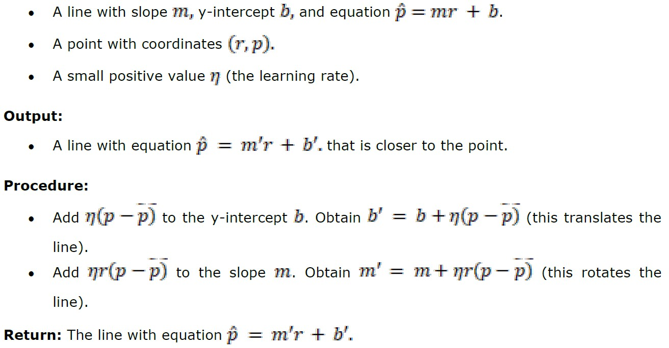
How machines formulate this equation?[The square trick]
Machine Learning

Slide 39
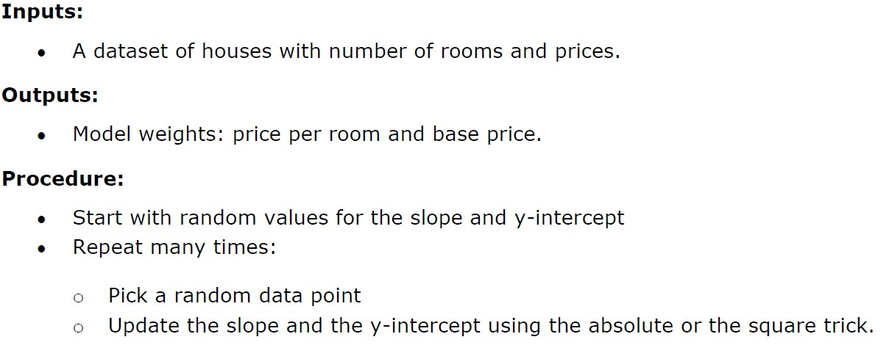
How machines formulate this equation?[The full algorithm]
Machine Learning

Slide 40
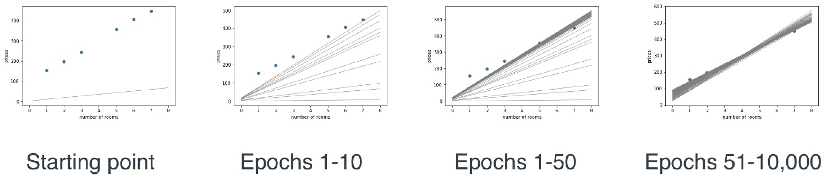
How machines formulate this equation?[The full algorithm]
Machine Learning

Slide 41
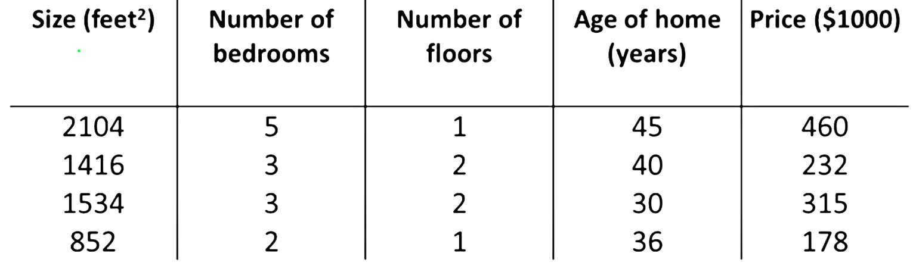
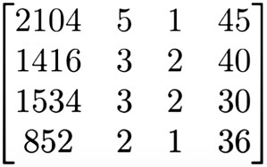
How machines formulate this equation?[Multivariate]
W₁
W₂ W₃ W₄
y’₁
y’₂
y’₃
y’₄
Machine Learning

Slide 42
How machines formulate this equation?[Multivariate]
X₁
X₂
X₃
X₄
W₁
W₂ W₃ W₄
y’₁
y’₂
y’₃
y’₄
Machine Learning

Slide 43
How machines formulate this equation?[Multivariate]
X₁
X₂
X₃
X₄
Y
W₁
W₂ W₃ W₄
y’₁
y’₂
y’₃
y’₄
Machine Learning

Slide 44
How machines formulate this equation?[Multivariate]
X₁
X₂
X₃
X₄
Y
_{X}(1)
W₁
W₂ W₃ W₄
y’₁
y’₂
y’₃
y’₄
Machine Learning

Slide 45
How machines formulate this equation?[Multivariate]
X₁
X₂
X₃
X₄
Y
_{X}(1)
_{X}(2)
_{X}(3)
_{X}(4)
W₁
W₂ W₃ W₄
y’₁
y’₂
y’₃
y’₄
Machine Learning

Slide 46
How machines formulate this equation?[Multivariate]
feature
X₁
X₂
X₃
X₄
Y
_{X}(1)
_{X}(2)
_{X}(3)
_{X}(4)
W₁
W₂ W₃ W₄
y’₁
y’₂
y’₃
y’₄
Machine Learning

Slide 47
How machines formulate this equation?[Multivariate]
feature
X₁
X₂
X₃
X₄
Y
Data Sample
_{X}(1)
_{X}(2)
_{X}(3)
_{X}(4)
W₁
W₂ W₃ W₄
y’₁
y’₂
y’₃
y’₄
Machine Learning

Slide 48
How machines formulate this equation?[Multivariate]
feature
X₁
X₂
X₃
X₄
Y
Data Sample
_{X}(1)
_{X}(2)
_{X}(3)
_{X}(4)
Weights W₁
W₂
W₃
W₄
W₁
W₂ W₃ W₄
y’₁
y’₂
y’₃
y’₄
Machine Learning

Slide 49
How machines formulate this equation?[Multivariate]
feature
X₁
X₂
X₃
X₄
Y
Data Sample
_{X}(1)
_{X}(2)
_{X}(3)
_{X}(4)
Weights W₁
W₂
W₃
W₄
W₁
W₂ W₃ W₄
W₁
W₂ W₃ W₄
y’₂
y’₃
y’₄
y’₁
X
* W
+ b = Y’
y’₂
y’₃
y’₄
Machine Learning

Slide 50
How machines formulate this equation?[Multivariate]
feature
X₁
X₂
X₃
X₄
Y
Data Sample
_{X}(1)
_{X}(2)
_{X}(3)
_{X}(4)
Weights W₁
W₂
W₃
W₄
W₁
W₂ W₃ W₄
W₁
W₂ W₃ W₄
y’₂
y’₃
y’₄
y’₁
X
* W
+ b = Y’
y’₂
y’₃
y’₄
Machine Learning

Slide 51
How machines formulate this equation?[Multivariate]
feature
X₁
X₂
X₃
X₄
Y
Data Sample
_{X}(1)
_{X}(2)
_{X}(3)
_{X}(4)
Weights W₁
W₂
W₃
W₄
W₁
W₂ W₃ W₄
W₁ W₂ W₃ W₄
y’₁
y’₂
y’₃
y’₄
X
* W
+ b = Y’
y’₂
y’₃
y’₄
Machine Learning

Slide 52
How machines formulate this equation?[Multivariate]
feature
X₁
X₂
X₃
X₄
Y
Data Sample
_{X}(1)
_{X}(2)
_{X}(3)
_{X}(4)
Weights W₁
W₂
W₃
W₄
W₁ W₂ W₃ W₄
y’₁
W₁
W₂ W₃ W₄
y’₂
y’₃
y’₄
X
* W
+ b = Y’
y’₂
y’₃
y’₄
Machine Learning

Slide 53
How machines formulate this equation?[Multivariate]
feature
X₁
X₂
X₃
X₄
Y
Data Sample
_{X}(1)
_{X}(2)
_{X}(3)
_{X}(4)
Weights W₁
W₂
W₃
W₄
W₁ W₂ W₃ W₄
y’₁
W₁
W₂ W₃ W₄
y’₂
y’₃
y’₄
X
* W
+ b = Y’
y’₂
y’₃
y’₄
Machine Learning

Slide 54
How machines formulate this equation?[Multivariate]
feature
X₁
X₂
X₃
X₄
Y
Data Sample
_{X}(1)
_{X}(2)
_{X}(3)
_{X}(4)
Weights W₁
W₂
W₃
W₄
W₁ W₂ W₃ W₄
y’₁
y’₂
y’₃
y’₄
W₁
W₂ W₃ W₄
X
* W
+ b = Y’
y’₂
y’₃
y’₄
Machine Learning

Slide 55
How machines formulate this equation?[Multivariate]
feature
X₁
X₂
X₃
X₄
Y
Data Sample
_{X}(1)
_{X}(2)
_{X}(3)
_{X}(4)
Weights W₁
W₂
W₃
W₄
W₁ W₂ W₃ W₄
y’₁
y’₂
y’₃
y’₄
W₁
W₂ W₃ W₄
X
* W
+ b = Y’
y’₂
y’₃
y’₄
[ #samples* #features ]
Machine Learning

Slide 56
How machines formulate this equation?[Multivariate]
feature
X₁
X₂
X₃
X₄
Y
Data Sample
_{X}(1)
_{X}(2)
_{X}(3)
_{X}(4)
Weights W₁
W₂
W₃
W₄
W₁ W₂ W₃ W₄
[ #features*1 ]
y’₁
y’₂
y’₃
y’₄
W₁
W₂ W₃ W₄
X
* W
+ b = Y’
y’₂
y’₃
y’₄
[ #samples* #features ]
Machine Learning

Slide 57
How machines formulate this equation?[Multivariate]
feature
X₁
X₂
X₃
X₄
Y
Data Sample
_{X}(1)
_{X}(2)
_{X}(3)
_{X}(4)
Weights W₁
W₂
W₃
W₄
W₁ W₂ W₃ W₄
[ #features*1 ]
y’₁
y’₂
y’₃
y’₄
[ #samples*1 ]
W₁
W₂ W₃ W₄
X
* W
+ b = Y’
y’₂
y’₃
y’₄
[ #samples* #features ]
Machine Learning

Slide 58
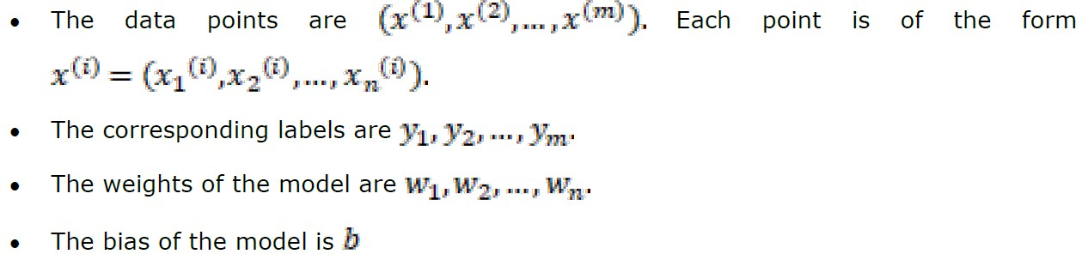
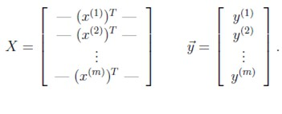
How machines formulate this equation?[Multivariate]
m*n
m*1
W₁
W₂ W₃ W₄
y’₂
y’₃
y’₄
Machine Learning

Slide 59
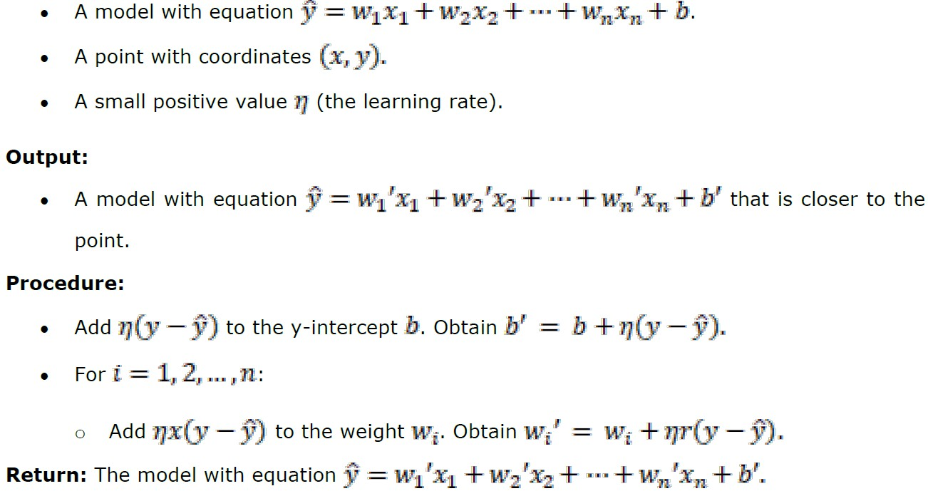
How machines formulate this equation?[Multivariate]
W₁
W₂ W₃ W₄
y’₂
y’₃
y’₄
Machine Learning

Slide 60
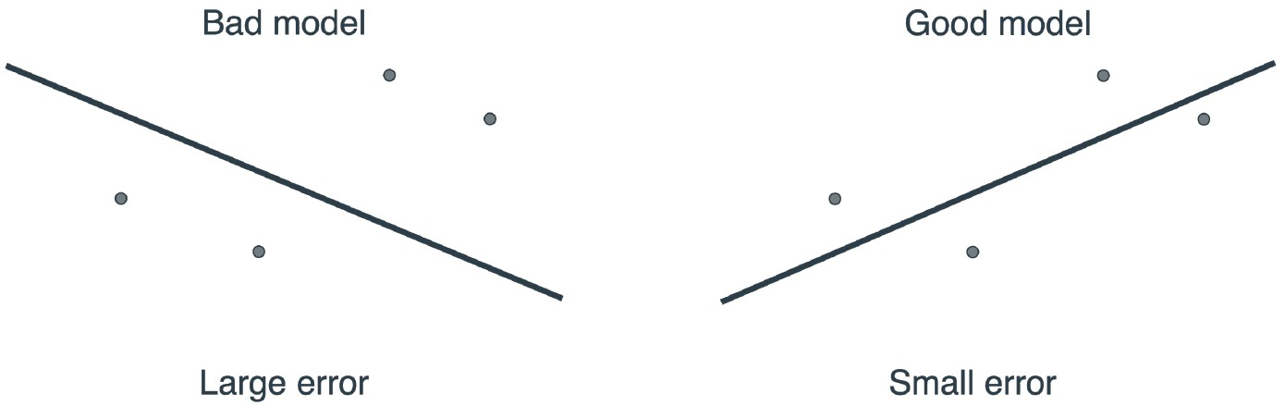
Is our model good or bad?
Which model is better and why?
W₁
W₂ W₃ W₄
y’₂
y’₃
y’₄
Machine Learning

Slide 61
Is our model good or bad?
Which model is better and why?
W₁
W₂ W₃ W₄
y’₂
y’₃
y’₄
Machine Learning

Slide 62
Absolute Error
W₁
W₂ W₃ W₄
y’₂
y’₃
y’₄
Machine Learning

Slide 63
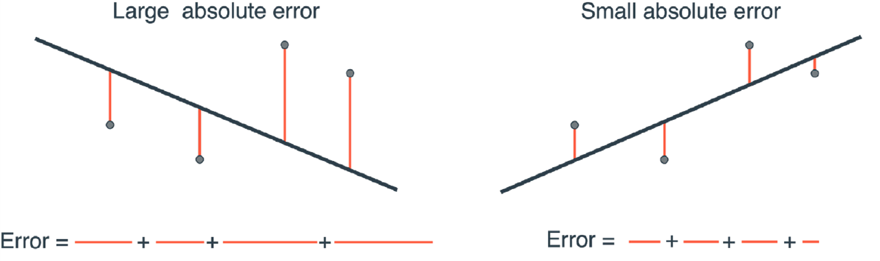
Absolute Error
W₁
W₂ W₃ W₄
y’₂
y’₃
y’₄
Machine Learning

Slide 64
Absolute Error
W₁
W₂ W₃ W₄
y’₂
y’₃
y’₄
Machine Learning

Slide 65
Square Error
W₁
W₂ W₃ W₄
y’₂
y’₃
y’₄
Machine Learning

Slide 66
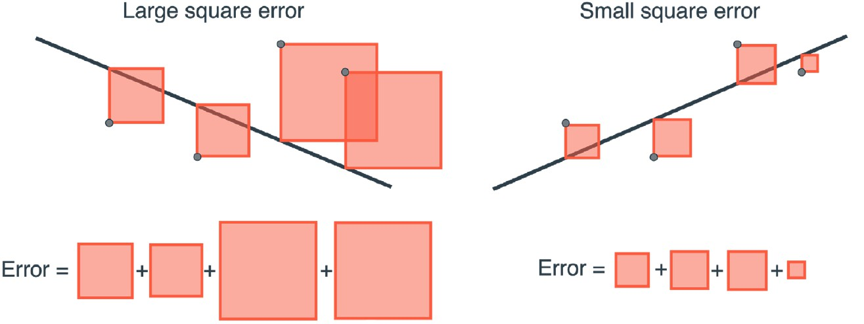
Square Error
W₁
W₂ W₃ W₄
y’₂
y’₃
y’₄
Machine Learning

Slide 67
Square Error
W₁
W₂ W₃ W₄
y’₂
y’₃
y’₄
Machine Learning

Slide 68
What is the best error (cost) function?
Absolute Error
|P’-P|
Enough to measure the error
Mean Square Error
1/n (P’-P)2
Enable comparing between models
Square Error
(P’-P)2
Nicer derivative
Root Mean Square error
root(1/n (P’-P)2)
Unit has a mean (Dollar square has no meaning)
Machine Learning

Slide 69
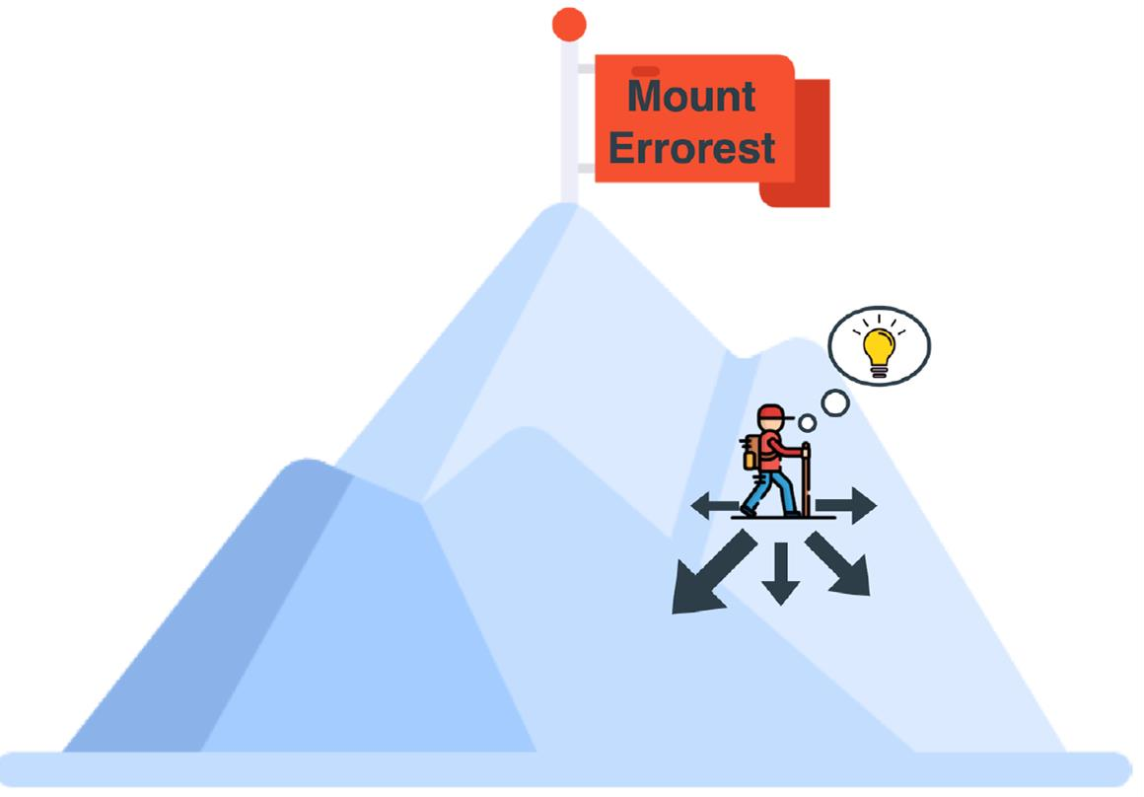
Gradient Descent
Should we think how to update the weights and bias for every problem like we thought how to get?
  NO
The story starts with the error (cost) function.
The machine’s goal is to decrease the error.
Here comes the gradient descent magic.
Machine Learning

Slide 70
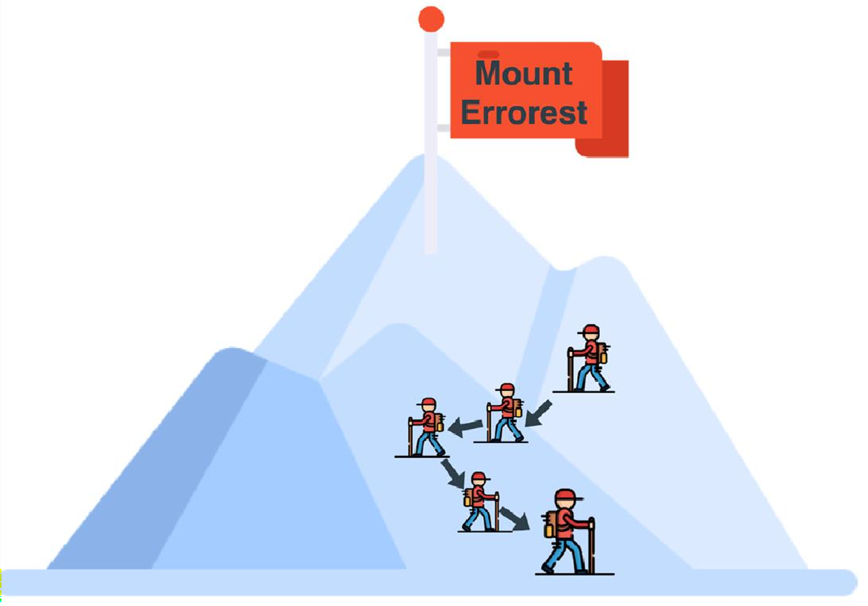
Gradient Descent
Should we think how to update the weights and bias for every problem like we thought how to get?
  NO
The story starts with the error (cost) function.
The machine’s goal is to decrease the error.
Here comes the gradient descent magic.
Machine Learning

Slide 71
Gradient Descent[Mathematics]
MSE(m)
MSE = 1/2n (P’-P)²
MSE = 1/2n ((mr+b)-P)²
m
Machine Learning

Slide 72
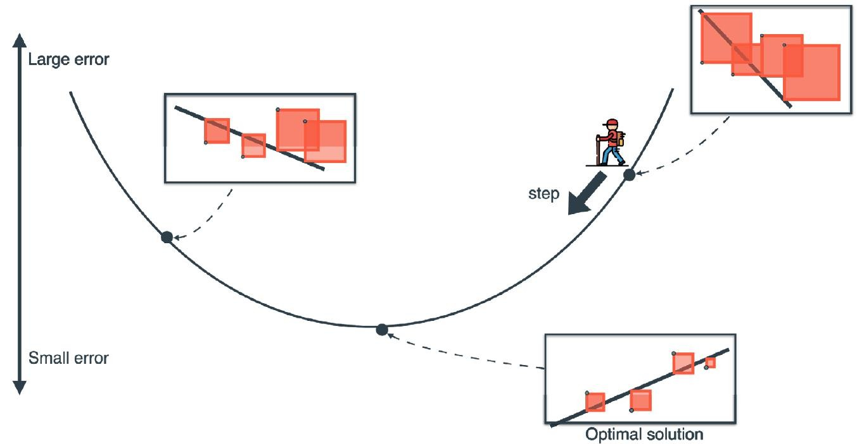
Gradient Descent[Mathematics]
Machine Learning

Slide 73
Gradient Descent[Mathematics]
Machine Learning

Slide 74
Gradient Descent[Mathematics]
Machine Learning

Slide 75
Gradient Descent[Mathematics]
Machine Learning

Slide 76
Batch vs Stochastic vs Mini-Batch Gradient Descent
m’=m - η * 1/n * (P’-P)r
When do we update the weights?
Batch Gradient Descent: Update weights after calculating the error over all the dataset.
Stochastic Gradient Descent: Update weights after calculating the error over only one point.
Mini-Batch Gradient Descent: Update weights after calculating the error over mini batch of points.
What is the difference between the 3 options?
Machine Learning

Slide 77
Batch vs Stochastic vs Mini-Batch Gradient Descent
m’=m - η * 1/n * (P’-P)r
When do we update the weights?
Batch Gradient Descent: Update weights after calculating the error over all the dataset.
[Takes a lot of time]
Stochastic Gradient Descent: Update weights after calculating the error over only one point.
[Not stable]
Mini-Batch Gradient Descent: Update weights after calculating the error over mini batch of points.
[balance between both]
What is the difference between the 3 options?
Machine Learning

Slide 78
Learning rate(η or α)
m’=m - η * 1/n * (P’-P)r
Machine learning models includes:
  Parameters: which is been trained for. (Weights and biases)
  Hyperparameters: which is parameters with a known value before training like learning rate- number of epochs.
Learning rate cases:
  Low: small steps and long training time
  High: Not converging
  Optimal: conversion in short time
Machine Learning

Slide 79
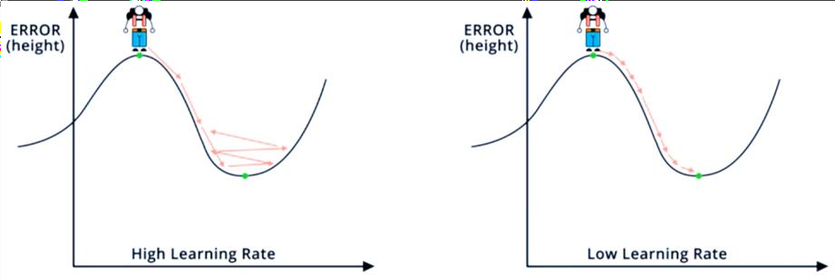
Learning rate(η or α)
Machine Learning

Slide 80
THANK YOU!
Any Question!
The End

